Slide 1
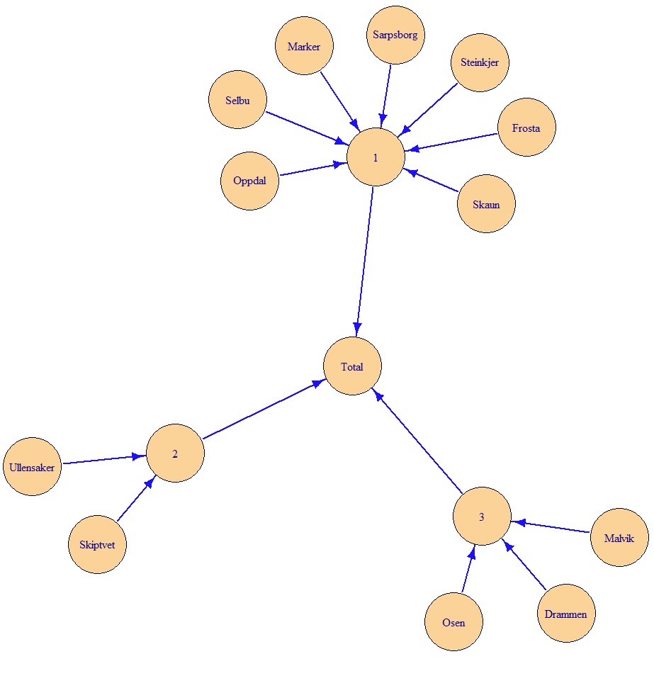
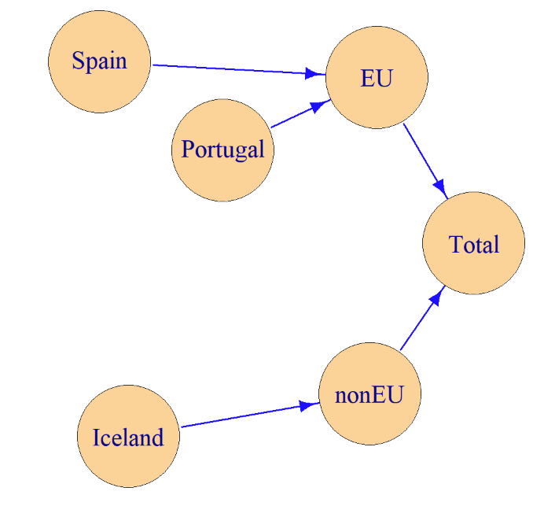
Statistical Disclosure Control (SDC) day 3, part 2
hierarchies
removeEmpty
removeCodes
01.03.2024

Slide 2
Contents
hierarchies
About hierarchies in general
And about the parameter named hierarchies
Applies to both volume and frequency tables
removeEmpty
About the parameter named removeEmpty
Applies to both volume and frequency tables
But for frequency tables, there are related issues that will be addressed later
removeCodes
About the parameter named removeCodes
This parameter only applies to volume tables
Examples and exercises will be based on volume tables

Slide 3
Hierarchies
hierarchies

Slide 4
Example from vignette
> library(GaussSuppression)
> dataset <- SSBtoolsData("magnitude1")
> dataset
sector4 sector2 geo eu company value
1 Agriculture private Portugal EU A 75.9
2 Agriculture private Portugal EU B 24.5
3 Agriculture private Spain EU A 96.6
4 Agriculture private Spain EU B 43.2
5 Entertainment private Iceland nonEU B 16.8
6 Entertainment private Portugal EU B 7.1
7 Entertainment private Portugal EU D 2.3
8 Entertainment private Spain EU A 77.4
9 Entertainment private Spain EU B 11.5
10 Entertainment private Spain EU C 16.4
11 Governmental public Portugal EU B 21.6
12 Governmental public Portugal EU D 2.0
13 Governmental public Spain EU C 6.5
14 Governmental public Spain EU D 2.7
15 Industry private Iceland nonEU B 9.6
16 Industry private Iceland nonEU C 8.8
17 Industry private Iceland nonEU D 1.9
18 Industry private Portugal EU B 25.7
19 Industry private Portugal EU D 3.4
20 Industry private Spain EU C 8.4
As you find on
https://CRAN.R-project.org/package=GaussSuppression

Slide 5
Example from vignette
> SuppressDominantCells(data=dataset,
numVar = "value",
dimVar = c("sector4", "sector2", "geo", "eu"),
n = 1:2, k = c(80, 99))
sector4 geo value primary suppressed
1 Total Total 462.3 - -
2 Total EU 425.2 - -
3 Total nonEU 37.1 - -
4 Total Iceland 37.1 - -
5 Total Portugal 162.5 - -
6 Total Spain 262.7 - -
7 private Total 429.5 - -
8 private EU 392.4 - -
9 private nonEU 37.1 - -
10 private Iceland 37.1 - -
11 private Portugal 138.9 - TRUE
12 private Spain 253.5 - TRUE
13 public Total 32.8 - -
14 public EU 32.8 - -
15 public nonEU 0.0 - -
16 public Iceland 0.0 - -
17 public Portugal 23.6 TRUE TRUE
18 public Spain 9.2 TRUE TRUE
19 Agriculture Total 240.2 - -
20 Agriculture EU 240.2 - -
21 Agriculture nonEU 0.0 - -
22 Agriculture Iceland 0.0 - -
23 Agriculture Portugal 100.4 TRUE TRUE
24 Agriculture Spain 139.8 TRUE TRUE
25 Entertainment Total 131.5 - -
26 Entertainment EU 114.7 - TRUE
27 Entertainment nonEU 16.8 TRUE TRUE
28 Entertainment Iceland 16.8 TRUE TRUE
29 Entertainment Portugal 9.4 TRUE TRUE
30 Entertainment Spain 105.3 - TRUE
31 Governmental Total 32.8 - -
32 Governmental EU 32.8 - -
33 Governmental nonEU 0.0 - -
34 Governmental Iceland 0.0 - -
35 Governmental Portugal 23.6 TRUE TRUE
36 Governmental Spain 9.2 TRUE TRUE
37 Industry Total 57.8 - -
38 Industry EU 37.5 - TRUE
39 Industry nonEU 20.3 - TRUE
40 Industry Iceland 20.3 - TRUE
41 Industry Portugal 29.1 TRUE TRUE
42 Industry Spain 8.4 TRUE TRUE
As you find on
https://CRAN.R-project.org/package=GaussSuppression

Slide 6
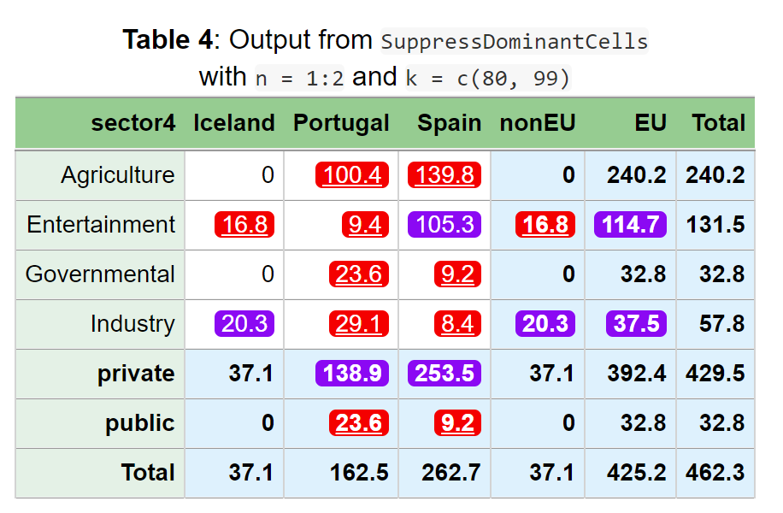
Example from vignette
As you find on
https://CRAN.R-project.org/package=GaussSuppression

Slide 7
How are variables combined?
4 variables in input dataset
How did 4 input variables become 2 output variables?
sector4 sector2 geo eu company value
1 Agriculture private Portugal EU A 75.9
2 Agriculture private Portugal EU B 24.5
3 Agriculture private Spain EU A 96.6
4 Agriculture private Spain EU B 43.2
:
sector4 geo value primary suppressed
1 Total Total 462.3 - -
2 Total EU 425.2 - -
3 Total nonEU 37.1 - -
4 Total Iceland 37.1 - -
5 Total Portugal 162.5 - -
6 Total Spain 262.7 - -
7 private Total 429.5 - -
8 private EU 392.4 - -
9 private nonEU 37.1 - -
10 private Iceland 37.1 - -
11 private Portugal 138.9 - TRUE
12 private Spain 253.5 - TRUE
:
2 variables in output dataset
Thus, the results could also be summarized in a two-way table as above.

Slide 8
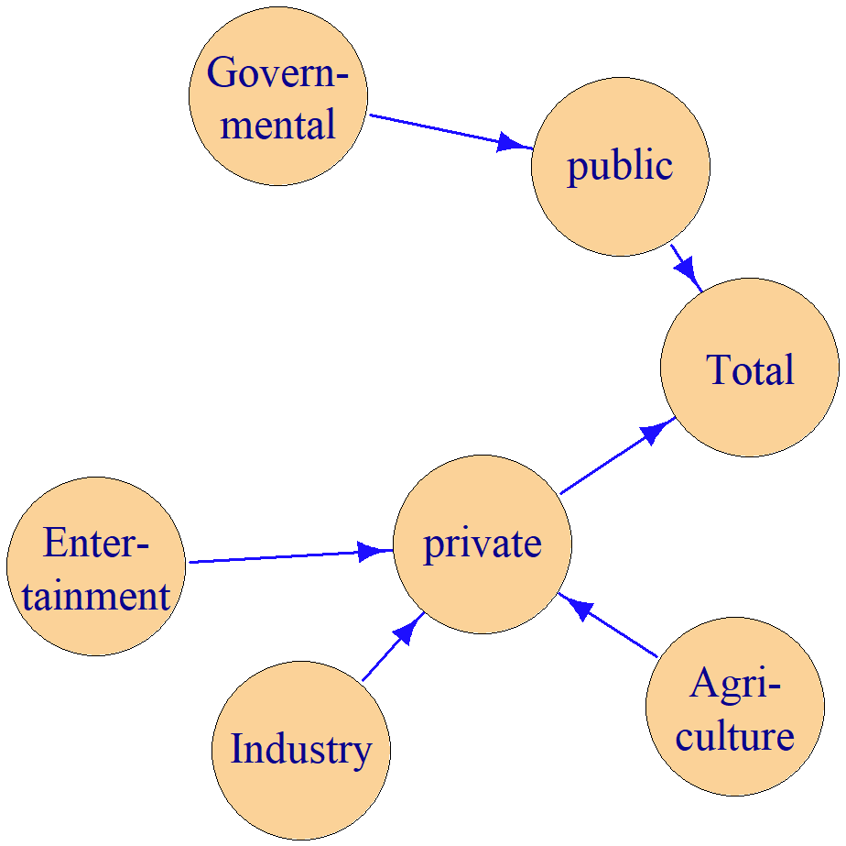
Two hierarchies were automatically discovered
Variable names from the most detailed variable
sector4
geo

Slide 9
• The hierarchy can also be described using the standards in R-package sdcTable or the program tauArgus.
• But the formula specifications on the right side are more general. A three structure is not needed.
formulas
Total = EU + nonEU
EU = Portugal + Spain
nonEU = Iceland
The formula here is completely different from the formula in the formula interface
sdcTable
levels | codes
@ | Total
@@ | EU
@@@ | Portugal
@@@ | Spain
@@ | nonEU
@@@ | Iceland
tauArgus
EU
@Portugal
@Spain
nonEU
@Iceland
mapsFrom | mapsTo | sign | level
EU | Total | 1 | 2
Portugal | EU | 1 | 1
Spain | EU | 1 | 1
nonEU | Total | 1 | 2
Iceland | nonEU | 1 | 1
The information in the formulas can also be written in a table like this. The column with levels means that you need to compute EU and nonEU first and the Europe.

Slide 10
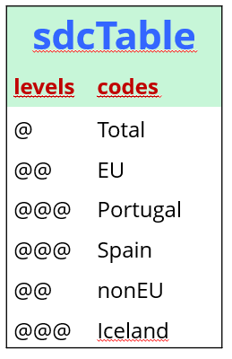
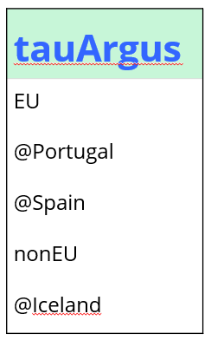
Hierarchies from data
> hi1 <- FindDimLists(dataset[c("sector4", "sector2", "geo", "eu")])
> hi1
$sector4
levels codes
1 @ Total
2 @@ private
3 @@@ Agriculture
4 @@@ Entertainment
5 @@@ Industry
6 @@ public
7 @@@ Governmental
$geo
levels codes
1 @ Total
2 @@ EU
3 @@@ Portugal
4 @@@ Spain
5 @@ nonEU
6 @@@ Iceland
> hi2 <- DimList2Hrc(hi1)
> hi2
$sector4
[1] "private" "@Agriculture" "@Entertainment"
"@Industry" "public" "@Governmental"
$geo
[1] "EU" "@Portugal" "@Spain" "nonEU" "@Iceland"
This is code to generate the sdcTable type hierarchy by using the FindDimLists function
This is a list of data frames
Names are the variable names
This is a list of data vectors
Names are the variable names
Above is code to convert hierarchy to the tau-Argus type hierarchy

Slide 11
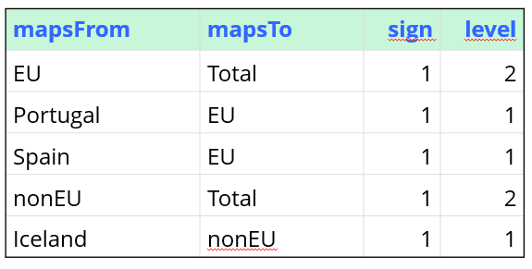
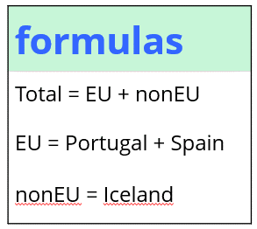
Hierarchies from data
> hi3 <- FindHierarchies(dataset[c("sector4", "sector2", "geo", "eu")])
> hi3
$sector4
mapsFrom mapsTo sign level
1 private Total 1 2
2 Agriculture private 1 1
3 Entertainment private 1 1
4 Industry private 1 1
5 public Total 1 2
6 Governmental public 1 1
$geo
mapsFrom mapsTo sign level
1 EU Total 1 2
2 Portugal EU 1 1
3 Spain EU 1 1
4 nonEU Total 1 2
5 Iceland nonEU 1 1
> hi4 <- Hierarchies2Formulas(hi3)
> hi4
$sector4
[1] "Total = private + public"
"private = Agriculture + Entertainment + Industry"
"public = Governmental"
$geo
[1] "Total = EU + nonEU“ "EU = Portugal + Spain" "nonEU = Iceland"
This is code to generate the from-to table by using the FindHierarchies function
This is a list of data frames
Names are the variable names
This is a list of data vectors
Names are the variable names
Above is code to convert hierarchy to the formula type hierarchy

Slide 12
Hierarchies can be input
In these variants, the eu variable is not needed
Just the same variables as the names of the hierarchies
That is, the most detailed
SuppressDominantCells(data=dataset,
numVar = "value",
hierarchies = hi1,
n = 1:2, k = c(80, 99))
SuppressDominantCells(data=dataset,
numVar = "value",
hierarchies = hi2,
n = 1:2, k = c(80, 99))
Then the parameter called hierarchies are used
All five variants give the same answer
SuppressDominantCells(data=dataset,
numVar = "value",
hierarchies = hi3,
n = 1:2, k = c(80, 99))
That, is the four hierarchy types and dimVar give the same answer
Automation with dimVar
Hierarchies are found from data with FindHierarchies
Then these hierarchies are used as input
SuppressDominantCells(data=dataset,
numVar = "value",
hierarchies = hi4,
n = 1:2, k = c(80, 99))
SuppressDominantCells(data=dataset,
numVar = "value",
dimVar= c("sector4", "sector2", "geo", "eu"),
n = 1:2, k = c(80, 99))

Slide 13
The dataset sdc_cars
Some random rows

Slide 14
The dataset sdc_cars
Aggregated to the municipal level

Slide 15
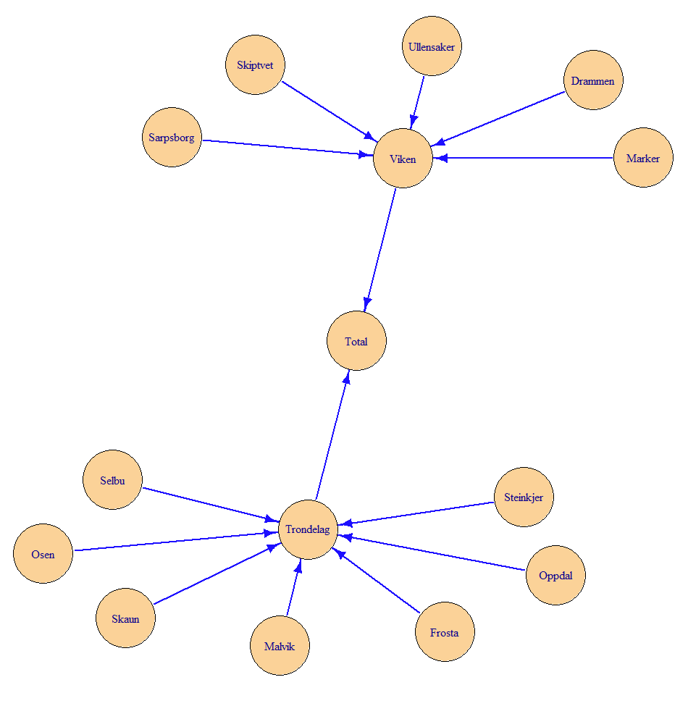
Tree structure = nested hierarchy
Tree structure when k-group is not included

Slide 16
Tree structure = nested hierarchy
Tree structure when county is not included

Slide 17
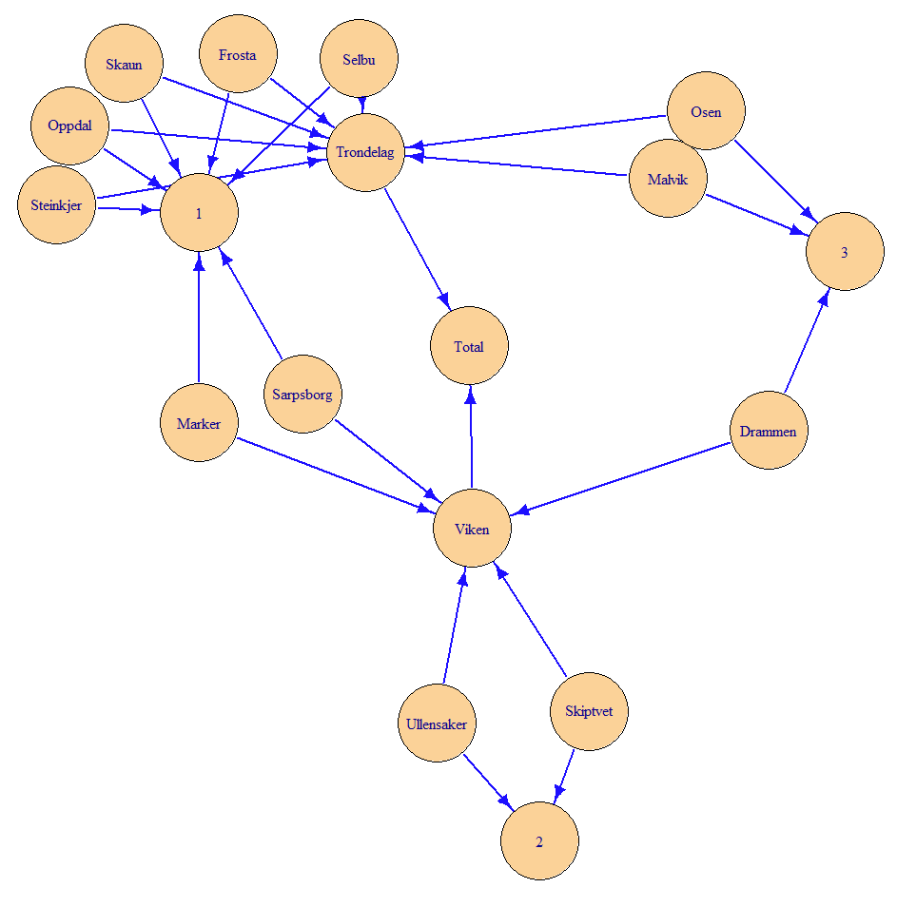
Non-tree structure = non-nested hierarchy
Non-tree structure when both county and k-group are included
Arrows to Total can be created in many ways

Slide 18
Two tree structures are found
> FindDimLists(sdc_cars[c("county", "municipality", "k_group", "sector", "months")])
$municipality
levels codes
1 @ Total
2 @@ Trondelag
3 @@@ Frosta
4 @@@ Malvik
5 @@@ Oppdal
6 @@@ Osen
7 @@@ Selbu
8 @@@ Skaun
9 @@@ Steinkjer
10 @@ Viken
11 @@@ Drammen
12 @@@ Marker
13 @@@ Sarpsborg
14 @@@ Skiptvet
15 @@@ Ullensaker
$municipality
levels codes
1 @ Total
2 @@ 1
3 @@@ Frosta
4 @@@ Marker
5 @@@ Oppdal
6 @@@ Sarpsborg
7 @@@ Selbu
8 @@@ Skaun
9 @@@ Steinkjer
10 @@ 2
11 @@@ Skiptvet
12 @@@ Ullensaker
13 @@ 3
14 @@@ Drammen
15 @@@ Malvik
16 @@@ Osen
$sector
levels codes
1 @ Total
2 @@ business
3 @@ individual
4 @@ other
5 @@ public
$months
levels codes
1 @ Total
2 @@ m01m05
3 @@ m06m09
4 @@ m10m12
The list has two elements with the same name
Here the name is municipality
This can be used for the hierarchies parameter
When names are the same, they are automatically combined

Slide 19
A non-nested hierarchy is generated
> FindHierarchies(sdc_cars[c("county", "municipality", "k_group", "sector", "months")])
$municipality
mapsFrom mapsTo sign level
1 Drammen Viken 1 1
2 Drammen Total 1 1
3 Drammen 3 1 1
4 Frosta Trondelag 1 1
5 Frosta Total 1 1
6 Frosta 1 1 1
7 Malvik Trondelag 1 1
8 Malvik Total 1 1
9 Malvik 3 1 1
10 Marker Viken 1 1
11 Marker Total 1 1
12 Marker 1 1 1
13 Oppdal Trondelag 1 1
14 Oppdal Total 1 1
15 Oppdal 1 1 1
16 Osen Trondelag 1 1
17 Osen Total 1 1
18 Osen 3 1 1
19 Sarpsborg Viken 1 1
20 Sarpsborg Total 1 1
21 Sarpsborg 1 1 1
22 Selbu Trondelag 1 1
23 Selbu Total 1 1
24 Selbu 1 1 1
25 Skaun Trondelag 1 1
26 Skaun Total 1 1
27 Skaun 1 1 1
28 Skiptvet Viken 1 1
29 Skiptvet Total 1 1
30 Skiptvet 2 1 1
31 Steinkjer Trondelag 1 1
32 Steinkjer Total 1 1
33 Steinkjer 1 1 1
34 Ullensaker Viken 1 1
35 Ullensaker Total 1 1
36 Ullensaker 2 1 1
Which can be used for the hierarchies parameter
$sector
mapsFrom mapsTo sign level
1 business Total 1 1
2 individual Total 1 1
3 other Total 1 1
4 public Total 1 1
$months
mapsFrom mapsTo sign level
1 m01m05 Total 1 1
2 m06m09 Total 1 1
3 m10m12 Total 1 1

Slide 20
Formulas and Hierarchy
SuppressDominantCells(data = sdc_cars,
n = 1:2, k = c(80, 99),
formula = ~municipality + county * k_group,
numVar = "value",
contributorVar = "car_brand")
municipality freq value primary suppressed
1 Total 582 1651372 - -
2 Drammen 17 49979 - TRUE
3 Frosta 135 483443 - -
4 Malvik 9 41920 - -
5 Marker 96 273243 - -
6 Oppdal 43 93190 - -
7 Osen 37 98597 - -
8 Sarpsborg 50 119646 - -
9 Selbu 67 151412 - -
10 Skaun 87 234433 - -
11 Skiptvet 3 7217 TRUE TRUE
12 Steinkjer 35 97731 - -
13 Ullensaker 3 561 - -
14 Trondelag 413 1200726 - -
15 Viken 169 450646 - -
16 1 513 1453098 - -
17 2 6 7778 TRUE TRUE
18 3 63 190496 - TRUE
19 Trondelag:1 367 1060209 - -
20 Trondelag:3 46 140517 - -
21 Viken:1 146 392889 - -
22 Viken:2 6 7778 TRUE TRUE
23 Viken:3 17 49979 - TRUE
Hierarchies are also automatically generated when using the formula interface
Can be turned off with avoidHierarchical = TRUE
But you still need to ensure that the formula you write corresponds with the hierarchy
You probably don't want to cross county with k-group
But if you do, the output you get is not incorrect
With the formula interface, hierarchy is used to
Collect output in a common column
For extend0
More on that later (frequence tables)

Slide 22
Hierarchy Input
The use of the from-to table is the most flexible
And it's the standard used internally in the package
Hierarchies as formulas are essentially the same
But it can go wrong when there are special characters in the codes
scdTable/dimList
Use this if it fits. Perhaps hierarchies are originally created for the sdcTable package
tauArgus/Hrc
Use this if it fits. Perhaps hierarchies are originally made for the tauArgus software

Slide 23
Differences between GaussSuppression, sdcTable og Tau-Argus
sdcTable and Tau-Argus
Only tree structure hierarchies are possible
Anything else must be handled with special functionality for linked tables
Only two linked tables are possible in sdcTable
GaussSuppression
More flexible hierarchies
The Gauss algorithm works the same way regardless
Also when multiple tables are specified with the formula interface
The formula interface does not exist in sdcTable and Tau-Argus

Slide 24
If you want to create a hierarchy manually
$age
mapsFrom mapsTo sign
1 old Total 1
2 young Total 1
$geo
mapsFrom mapsTo sign
1 EU Total 1
2 Portugal EU 1
3 Spain EU 1
4 nonEU Total 1
5 Iceland nonEU 1
mapsFrom | mapsTo | sign | level
EU | Total | 1 | 2
Portugal | EU | 1 | 1
Spain | EU | 1 | 1
nonEU | Total | 1 | 2
Iceland | nonEU | 1 | 1
The level column can be removed
The sign column should only have 1s
The possibility for -1 is designed for purposes other than suppression

Slide 25
A difference between the hierarchy and formula interface
removeEmpty

Slide 26
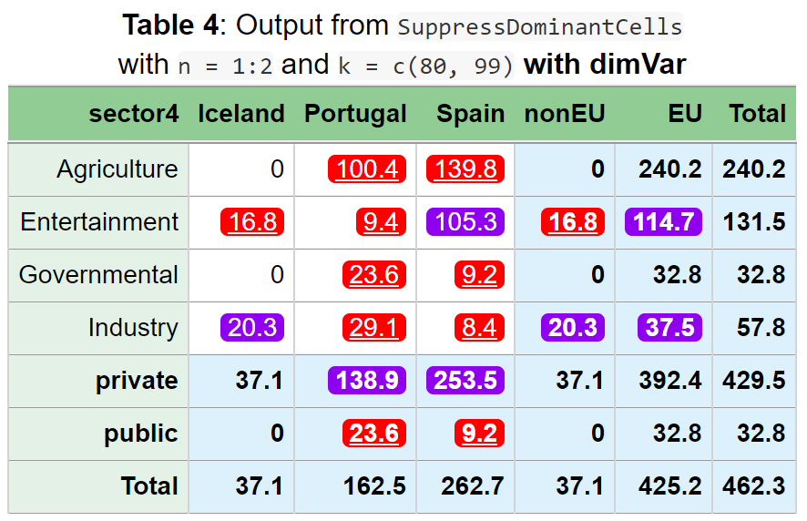
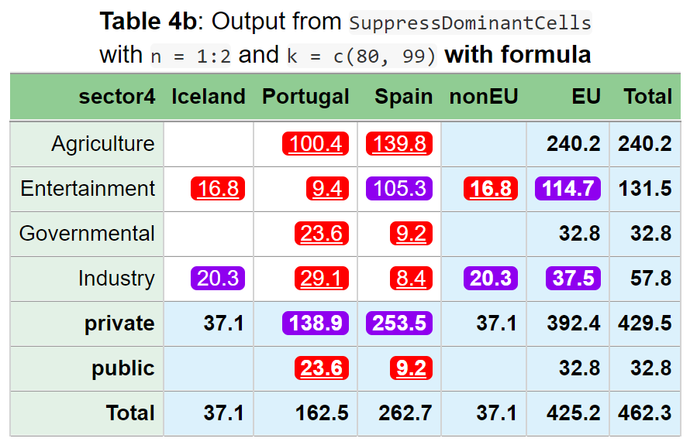
SuppressDominantCells(data=dataset,
numVar = "value",
dimVar = c("sector4", "sector2", "geo", "eu"),
n = 1:2,
k = c(80, 99))
Can you see the difference in output?
SuppressDominantCells(data=dataset,
numVar = "value",
formula = ~(sector4 + sector2)*(geo + eu),
n = 1:2,
k = c(80, 99))

Slide 27
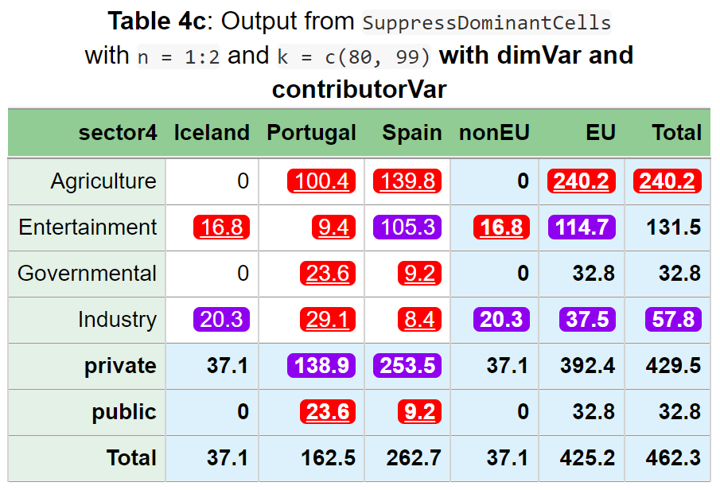
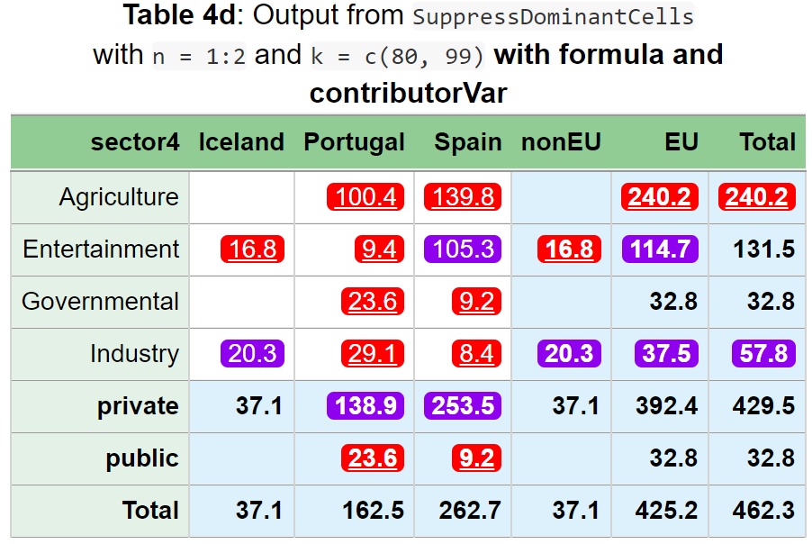
SuppressDominantCells(data=dataset,
numVar = "value",
dimVar = c("sector4", "sector2", "geo", "eu"),
n = 1:2,
k = c(80, 99),
contributorVar = "company")
Can you see the difference in output?
SuppressDominantCells(data=dataset,
numVar = "value",
formula = ~(sector4 + sector2)*(geo + eu),
n = 1:2,
k = c(80, 99),
contributorVar = "company")

Slide 28
> SuppressDominantCells(data=dataset,
numVar = "value",
dimVar = c("sector4", "sector2", "geo", "eu"),
n = 1:2, k = c(80, 99),
contributorVar = "company")
sector4 geo freq value primary suppressed
1 Total Total 20 462.3 - -
2 Total EU 16 425.2 - -
3 Total nonEU 4 37.1 - -
4 Total Iceland 4 37.1 - -
5 Total Portugal 8 162.5 - -
6 Total Spain 8 262.7 - -
7 private Total 16 429.5 - -
8 private EU 12 392.4 - -
9 private nonEU 4 37.1 - -
10 private Iceland 4 37.1 - -
11 private Portugal 6 138.9 - TRUE
12 private Spain 6 253.5 - TRUE
13 public Total 4 32.8 - -
14 public EU 4 32.8 - -
15 public nonEU 0 0.0 - -
16 public Iceland 0 0.0 - -
17 public Portugal 2 23.6 TRUE TRUE
18 public Spain 2 9.2 TRUE TRUE
19 Agriculture Total 4 240.2 TRUE TRUE
20 Agriculture EU 4 240.2 TRUE TRUE
21 Agriculture nonEU 0 0.0 - -
22 Agriculture Iceland 0 0.0 - -
23 Agriculture Portugal 2 100.4 TRUE TRUE
24 Agriculture Spain 2 139.8 TRUE TRUE
25 Entertainment Total 6 131.5 - -
26 Entertainment EU 5 114.7 - TRUE
27 Entertainment nonEU 1 16.8 TRUE TRUE
28 Entertainment Iceland 1 16.8 TRUE TRUE
29 Entertainment Portugal 2 9.4 TRUE TRUE
30 Entertainment Spain 3 105.3 - TRUE
31 Governmental Total 4 32.8 - -
32 Governmental EU 4 32.8 - -
33 Governmental nonEU 0 0.0 - -
34 Governmental Iceland 0 0.0 - -
35 Governmental Portugal 2 23.6 TRUE TRUE
36 Governmental Spain 2 9.2 TRUE TRUE
37 Industry Total 6 57.8 - TRUE
38 Industry EU 3 37.5 - TRUE
39 Industry nonEU 3 20.3 - TRUE
40 Industry Iceland 3 20.3 - TRUE
41 Industry Portugal 2 29.1 TRUE TRUE
42 Industry Spain 1 8.4 TRUE TRUE
Additionally, the rows are sorted differently.
These are missing when using a formula"

Slide 29
The removeEmpty parameter
Determines whether combinations that have no contribution from input should be included in the output
Default:
TRUE in the formula interface
FALSE in the hierarchy interface and for dimVar
But always possible to specify it manually

Slide 30
How to consider open data?
removeCodes

Slide 31
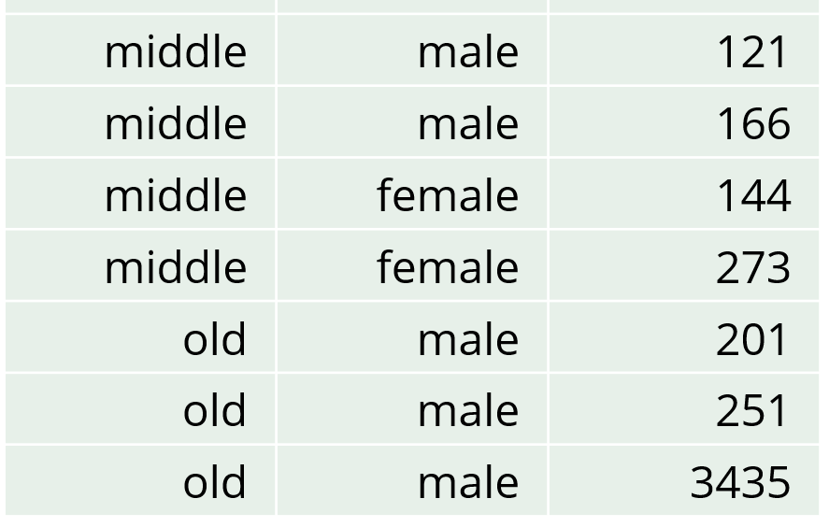
Estimate a value with high accuracy in a magnitude table
age | gender | income | freq
young | female | 328 | 3
young | male | 105 | 1
middle | female | 417 | 2
middle | male | 395 | 3
old | female | 0 | 0
old | male | 3887 | 3
 | young | middle | old | Total
female | 328 | 417 | 0 | 745
male | 105 | 395 | 3887 | 4387
Total | 433 | 812 | 3887 | 5132
This value can be used to estimate …
This value can be used to estimate …
Suppose one person's income is openly available
The old-male value, 201
Everybody can subtract this value
The relevant cell total is therefore 3686
The relevant number of contributors is therefore 2
Primary suppression should be based on these relevant numbers

Slide 32
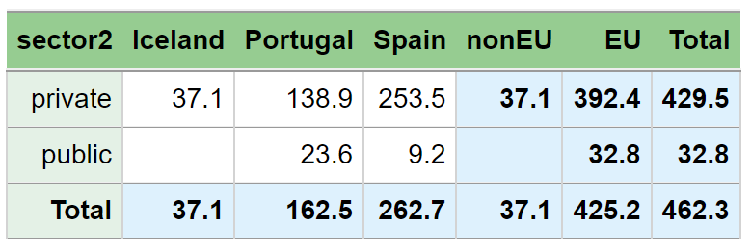
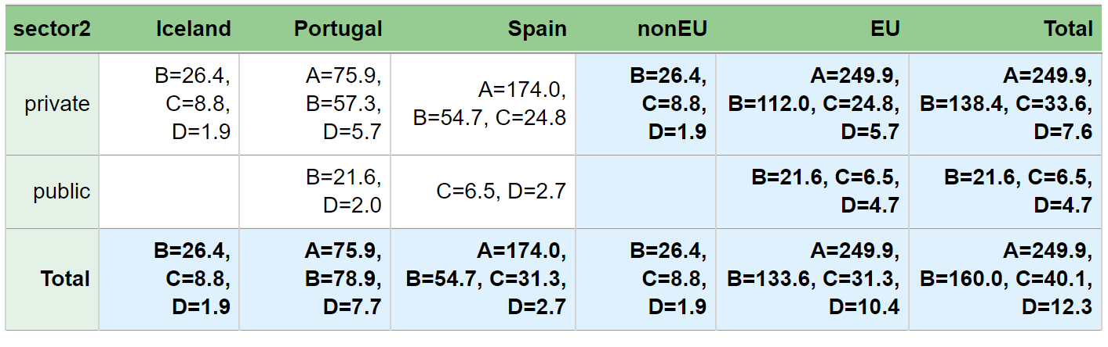
What if the numbers from C and D are openly available?
No suppression when maxN = 1
in SuppressFewContributors

Slide 33
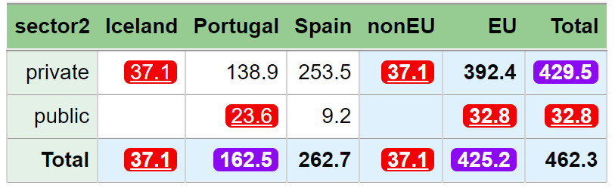
What if the numbers from C and D are openly available?
Here is the new suppression pattern with maxN = 1 and by considering C and D as open

Slide 34
> SuppressFewContributors(data = dataset,
numVar = "value",
formula = ~sector2 * (geo + eu),
maxN = 1,
contributorVar = "company",
removeCodes = c("C", "D"))
sector2 geo freq value nRule nAll primary suppressed
1 Total Total 20 462.3 2 4 - -
2 private Total 16 429.5 2 4 - TRUE
3 public Total 4 32.8 1 3 TRUE TRUE
4 Total Iceland 4 37.1 1 3 TRUE TRUE
5 Total Portugal 8 162.5 2 3 - TRUE
6 Total Spain 8 262.7 2 4 - -
7 Total EU 16 425.2 2 4 - TRUE
8 Total nonEU 4 37.1 1 3 TRUE TRUE
9 private Iceland 4 37.1 1 3 TRUE TRUE
10 private Portugal 6 138.9 2 3 - -
11 private Spain 6 253.5 2 3 - -
12 public Portugal 2 23.6 1 2 TRUE TRUE
13 public Spain 2 9.2 0 2 - -
14 private EU 12 392.4 2 4 - -
15 private nonEU 4 37.1 1 3 TRUE TRUE
16 public EU 4 32.8 1 3 TRUE TRUE
C and D being openly available are handled by the removeCodes parameter
nAll = the number of contributors
nRule = the number of relevant contributors for the suppression rule

Slide 35
How to consider open data? Solution in practice:
SuppressFewContributors
Use the parameter removeCodes
SuppressDominantCells
Use the parameter removeCodes

Slide 36
> SuppressDominantCells(data=dataset,
numVar = "value",
formula = ~sector2*(geo + eu),
n = 1, k = 99,
contributorVar = "company",
removeCodes = c("C", "D"))
sector2 geo freq value primary suppressed
1 Total Total 20 462.3 - -
2 private Total 16 429.5 - TRUE
3 public Total 4 32.8 TRUE TRUE
4 Total Iceland 4 37.1 TRUE TRUE
5 Total Portugal 8 162.5 - TRUE
6 Total Spain 8 262.7 - -
7 Total EU 16 425.2 - TRUE
8 Total nonEU 4 37.1 TRUE TRUE
9 private Iceland 4 37.1 TRUE TRUE
10 private Portugal 6 138.9 - -
11 private Spain 6 253.5 - -
12 public Portugal 2 23.6 TRUE TRUE
13 public Spain 2 9.2 - -
14 private EU 12 392.4 - -
15 private nonEU 4 37.1 TRUE TRUE
16 public EU 4 32.8 TRUE TRUE
Here is suppression pattern when considering C and D as open
With the relevant cell values in parentheses

Slide 37
Exercises
exercises/hierarchies.md
Direct link:
https://github.com/statisticsnorway/kurs-metode-sdc-2024/blob/main/exercises/hierarchies.md

